Slide 1
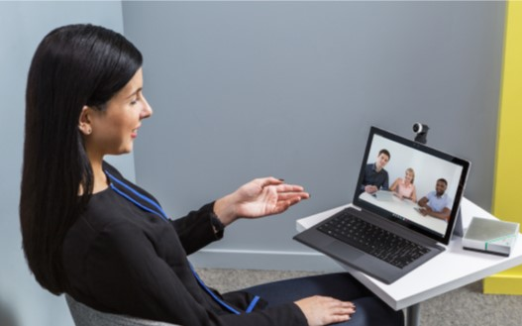
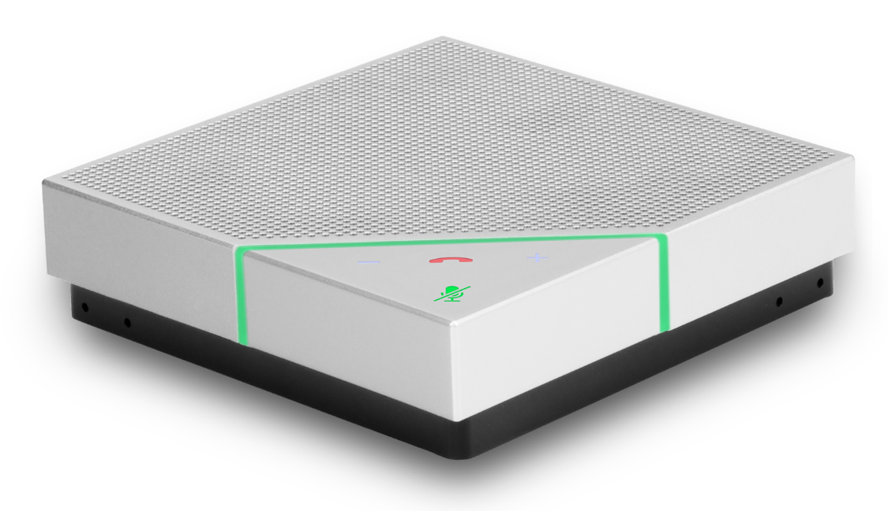
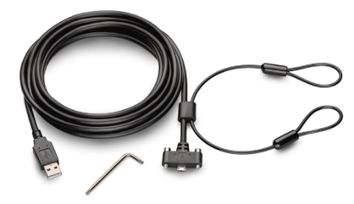
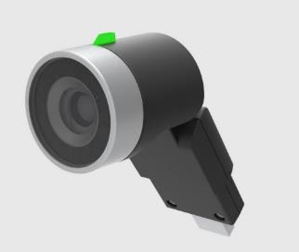
Polycom® VoxBoxTM Work Anywhere Kit
Polycom® VoxBox™ Speakerphone
Water / Dust resistant case
Survives accidental spills
Bluetooth® connectivity
6.5 hour battery talk time
Dedicated button makes wireless-pairing simple
Charges from USB
Business-class audio and video anywhere you work—at home, in the office, and on the road
Call controls
Four directional microphones
Answer/end calls, adjust volume, with one touch
Voice pickup from up to 10 ft/3 m
Polycom® NoiseBlockTM
Polycom EagleEye Mini USB Camera
Automatically mutes call when no one is speaking
LED status indicator
USB cable with locking mechanism
1080p 30fps H.264 and
Ensure speakerphone remains stationary
82° DFoV (74 °HFoV)
Electronic 4x pan/tilt/zoom
Skype for Business/SVC
Order Code: 7230-49025-001
Includes VoxBox and EagleEye Mini USB Camera
MSRP is $449
Simulcast video streams
Multiple mounting options
Integrated privacy shutter
USB UVC 1.5

